Slide 1
FAST API
PYTHON for Backend
- HDM Vision

Slide 2
Benefit
Easy to learn
Fast Development
High Performance

Slide 3
Install
pip install fastapi
Pip install uvicorn
Uvicorn = server for test and run FastAPI apps

Slide 4

Create Project Directory
Eg: FastAPILearn

Slide 5
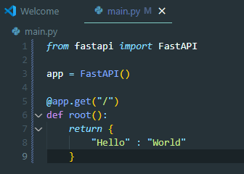
main.py

Slide 6
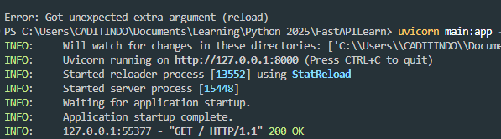
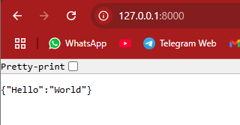
Run server
uvicorn main:app --reload
Main : file name
--reload: Auto refresh on file changes

Slide 7
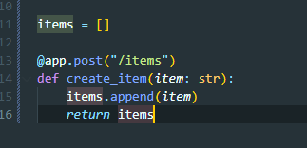
Creating Routes - POST
curl –X POST –H “Content-Type: application/json” ‘http://127.0.0.1:8000/items?item=apple’
Invoke-WebRequest -Uri 'http://127.0.0.1:8000/items?item=apple' -Method POST -Headers @{ "Content-Type" = "application/json" }

Slide 8
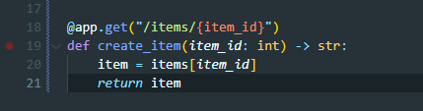
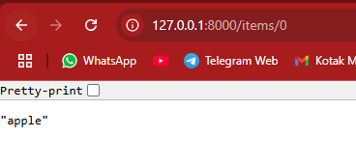
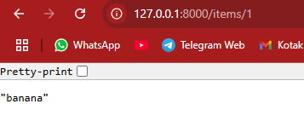
Creating Routes - GET
Curl –X GET http://127.0.0.1:8000/items/0
-> “apple”

Slide 9
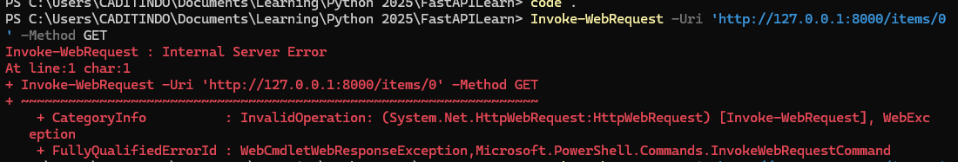
Raising Errors
To prevent this and get more info from the error

Slide 10
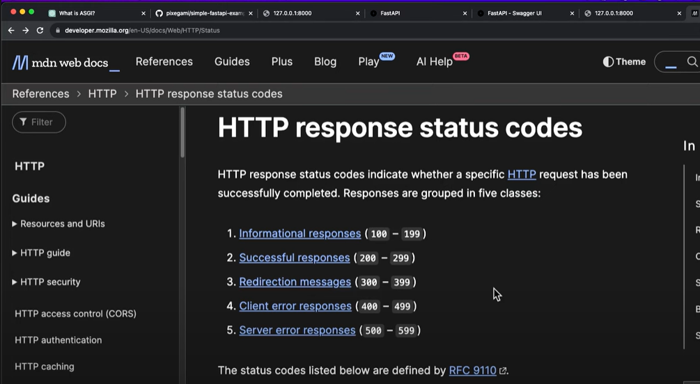

HTTP Response code

Slide 11
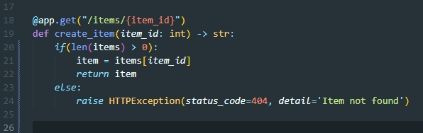
What to do?
Import HTTPException
Handle the code

Slide 12
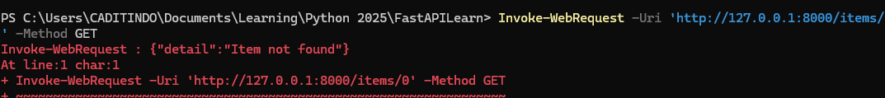
Meaningfull Error info

Slide 13

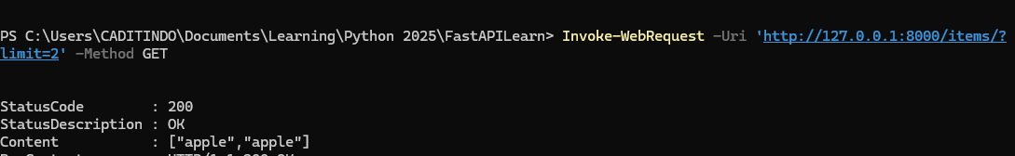
Request and Path parameters
Param example:

Slide 14
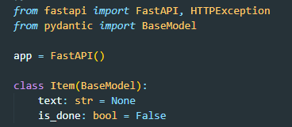
Pydantic Model
FastAPI also support Pydantic model, allow us to structure data and also provide additional validation.
Make testing, documentation, and code completion in out IDE a lot easier
Eg (todo list data):

Slide 15
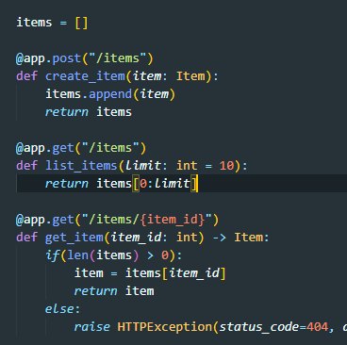
Use it as Data Type
Change string to Item

Slide 16
Curl –X POST –H “Content-Type: application/json” –d ‘{“text”:”apple”}’ ‘http://127.0.0.1:8000/items’
OR
Invoke-WebRequest -Uri 'http://127.0.0.1:8000/items' `
-Method POST `
-Body '{"text":"apple"}' `
-ContentType 'application/json'

Slide 17
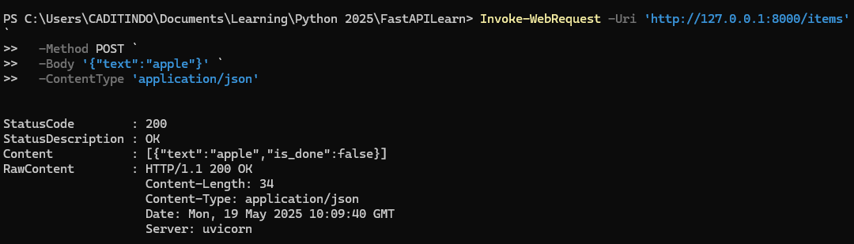

Slide 18

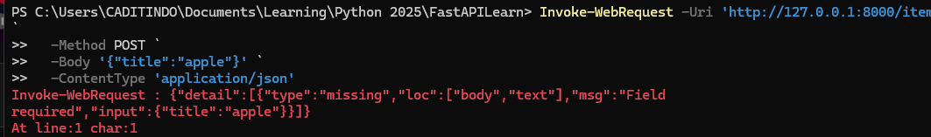
Make required field
Remove the default value

Slide 19
https://www.youtube.com/watch?v=iWS9ogMPOI0

